Slide 1
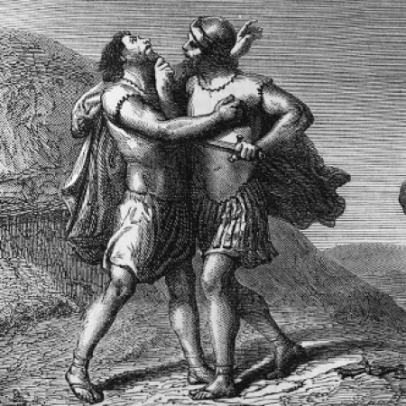
2 Samuel
Chapter 3

Slide 2
2Sa 3:20 So Abner came to David to Hebron, and twenty men with him. And David made Abner and the men that were with him a feast.
2Sam 3:21 And Abner said unto David, I will arise and go, and will gather all Israel unto my lord the king, that they may make a league with thee, and that thou mayest reign over all that thine heart desireth. And David sent Abner away; and he went in peace.

Slide 3
2Sam 3:26 And when Joab was come out from David, he sent messengers after Abner, which brought him again from the well of Sirah: but David knew [it] not. 27 And when Abner was returned to Hebron, Joab took him aside in the gate to speak with him quietly, and smote him there under the fifth [rib], that he died, for the blood of Asahel his brother.
2Sa 3:27 And when Abner was returned to Hebron, Joab took him aside in the gate to speak with him quietly, and smote him there under the fifth rib, that he died, for the blood of Asahel his brother.

Slide 4
Abner failed to discern his true enemy.

Slide 5
Matthew 16:24 Then said Jesus unto his disciples, If any man will come after me, let him deny himself, and take up his cross, and follow me.

Slide 6
Jesus sets DENIAL of SELF as a PREREQUISITE for discipleship.

Slide 7
THESIS:
You cannot live a successful Christian life until you discern YOUR FLESH as the deadly enemy it is and respond to it as such

Slide 8
DISCERNING AND DEALING WITH A DEADLY ENEMY: YOUR FLESH

Slide 9
Where a deadly enemy is concerned, you will either kill him or he will kill you.
Romans 7-8, Galatians 5

Slide 10
Your FLESH (old man) is an ENEMY of God and therefore a deadly enemy of YOU (a son of God). - Galatians 5:17

Slide 11
Contrary = Adversary

Slide 12
Contrary = Adversary
The flesh cannot be improved / repaired or fixed. Rom 7:18

Slide 13
Contrary = Adversary
The flesh cannot be improved / repaired or fixed. Rom 7:18
This is why God made you a NEW CREATURE at salvation. Gal 6:15, 2 Cor 5:17

Slide 14
“Well the main reason is a false sense of confidence in one’s own ability. A person who earns so much success without any recent or major setbacks tends to forget about their own vulnerabilities. In BJJ this happens a lot when you have a fighter winning a few competitions and dominating all his training partners in class. Then when the competition comes he finds himself stuck in bad positions and constantly reacting defensively to his opponents attacks and loses the tournament. So what happened? Well, when training, the fighter never assumed that he could be put in a bad situation. Otherwise he would have put himself in those tough situations in practice such as starting from a locked triangle choke. He underestimated his opponents ability to put him in danger and therefore never felt threatened enough to train properly.“

Slide 15
If you are consistently YIELDING to the LUSTS OF YOUR FLESH in your THOUGHT life. You are SETTING yourself up for a fall.

Slide 16
Example of a carnal life: Solomon
1 Kings 4:1
1 Kings 4:29-30
Eph 1:3, 17-23
Psalms 119:98
The Problem: 1 Kings 11: 1-10

Slide 17
Consequences of a carnal life: Solomon
External: God opposes you 1 Kings 11:14, 23, 25

Slide 18
A decision to live for your flesh is a decision to live as an enemy of God.

Slide 19
Consequences of a carnal life: Solomon
External: God opposes you. 1 Kings 11:14, 23, 25
Internal: Loss of peace. Ecc 2:11, 1 Pet 2:11

Slide 20
(2) Because the flesh is a deadly enemy, it must be MORTIFIED / KILLED.

Slide 21
  Rom 8:13 For if ye live after the flesh, ye shall die: but if ye through the Spirit do mortify the deeds of the body, ye shall live.
  Col 3:5 Mortify therefore your members which are upon the earth; fornication, uncleanness, inordinate affection, evil concupiscence, and covetousness, which is idolatry:
  Gal 5:24 And they that are Christ's have crucified the flesh with the affections and lusts.

Slide 22
Because of the finished work of Christ, I no longer have to do what my flesh is desiring.

Slide 23
YOU WILL STRUGGLE TO MORTIFY A PARTICULAR SIN UNTIL YOU ARE WILLING TO MORTIFY ALL SIN.

Slide 24
Living a Biblical Christian life means that you will have UNFULFILLED DESIRES in this life.

Slide 25
(3) The FLESH can only be mortified through the Spirit. Walking in the Spirit mortifies the flesh.

Slide 26
  Romans 8:1-8
  Colossians 3:2 Set your affection on things above, not on things on the earth.
  Pro 4:23 Keep thy heart with all diligence; for out of
  it are the issues of life.

Slide 27
If you don’t decide to be mortifying your flesh, it will be mortifying you!

Slide 28
Rom 8:1 There is therefore now no condemnation to them which are in Christ Jesus, who walk not after the flesh, but after the Spirit.

